Slide 1
AN ANALYSIS OF CRYPTOCURRENCIES AND AN IDEA APPLICABLE VIA SMART CONTRACTS
FA 595: Financial Technology
Beatrice Spinola, Yizhuo Hou, Zijian Li, Ning Li

Slide 2
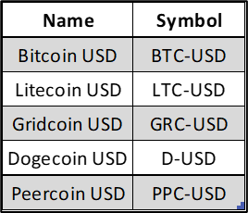
5 CRYPTOCURRENCIES SELECTED
Using the quantmod package in R, we downloaded historical data for the 5 cryptocurrencies listed on Yahoo Finance from January 1, 2022, to December 31, 2022.
Notes:
Using the quantmod package in R, we downloaded historical data for the 5 cryptocurrencies listed on Yahoo Finance from January 1, 2022, to December 31, 2022. Below are listed the names and symbols of the five cryptocurrencies we’ve selected.

Slide 3
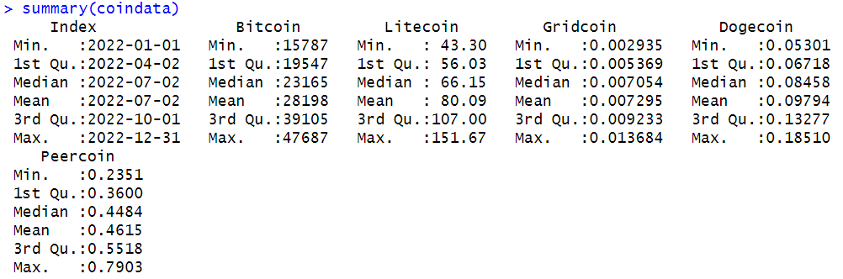
INSPECT OUR DATA SET FOR “NA” VALUES
Install the dplyr package and use the summary() function.
The summary function in R returned the following results:
Notes:
After we installed the dplyr package in R, we used the summary() function to check for any missing values. If any “NA” values are present in the data frame, the function summary() will return the number of missing values found in each variable. As you can see, the output of the summary function does not display any missing values.

Slide 4
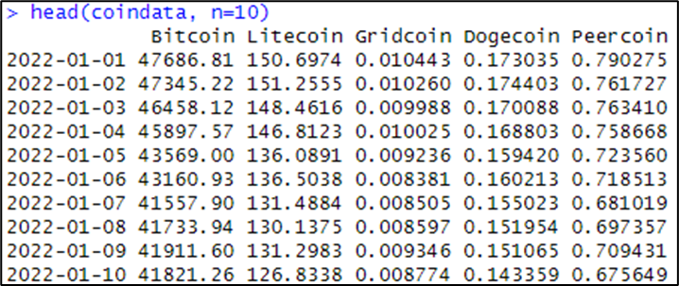
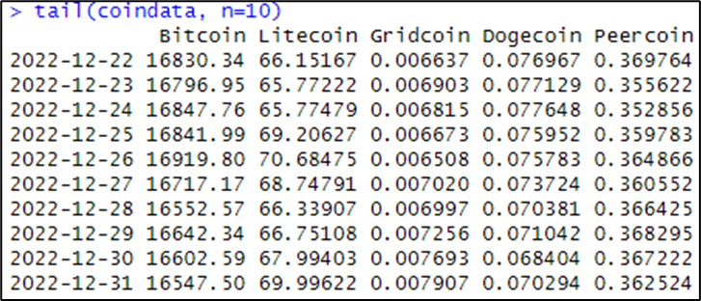
HEAD AND TAIL OF THE DATASET
The following are the first 10 rows of our data:
The following are the last 10 rows of our data:
Notes:
To further inspect the data for missing values we outputted the first and last 10 rows of our dataset. As you can see, we confirm there are no missing values present in the data.

Slide 5
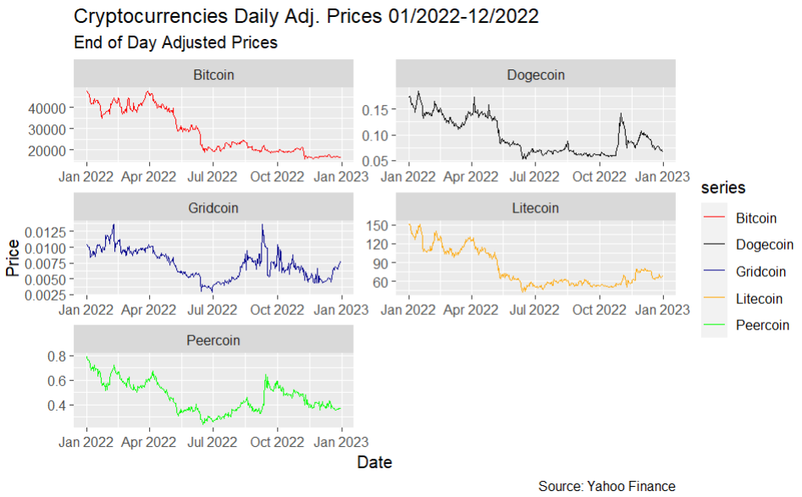
FIVE CRYPTOCURRENCIES ADJUSTED CLOSE PRICES
Notes:
We then plotted the Adjusted Close Prices for the five cryptocurrencies on the same plot but on separate axes. Note that the scale of each cryptocurrency axis greatly differs from one another, except for Dogecoin’s and Peercoin’s axes scales.

Slide 6
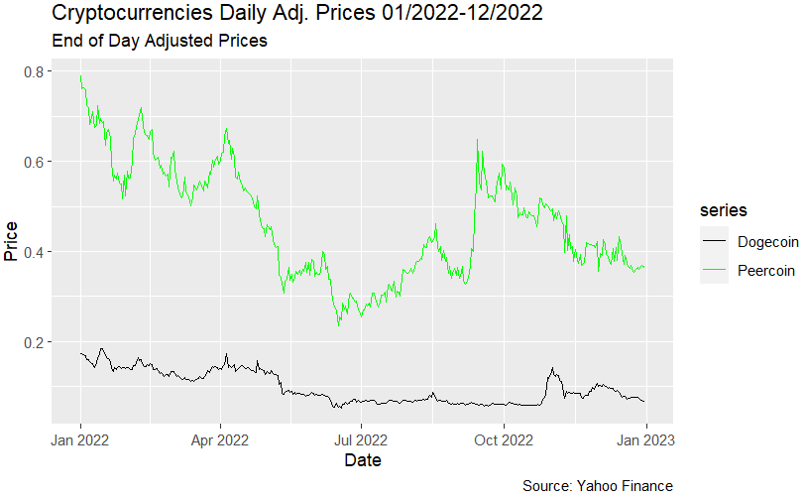
COMPARING DOGECOIN & PEERCOIN
Notes:
Based on the similarly scaled axes, we compared the Adjusted Close Prices of Dogecoin and Peercoin by plotting them on the same axis. Overall, Peercoin’s close prices are higher than Dogecoin’s close prices, but Dogecoin appears to be less volatile than Peercoin.

Slide 7
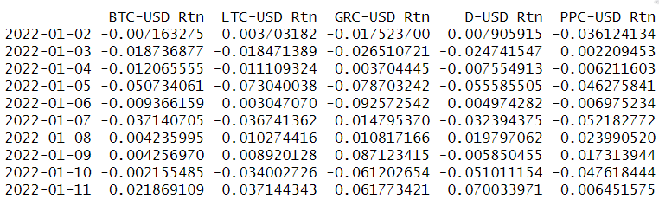
DAILY RETURNS HEADER
Notes:
Here we see the first 10 rows of the computed daily returns prices for the 5 cryptocurrencies.

Slide 8
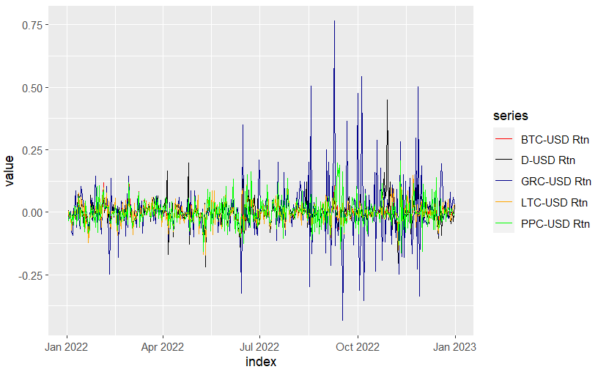
DAILY RETURNS PLOT
Notes:
This is a plot of all the daily return prices on the same axis. Although the plot is not clear, note that we can still observe that Gridcoin (the blue line) seems to have the greatest spikes, both in the positive and negative direction, indicating higher volatility.

Slide 9
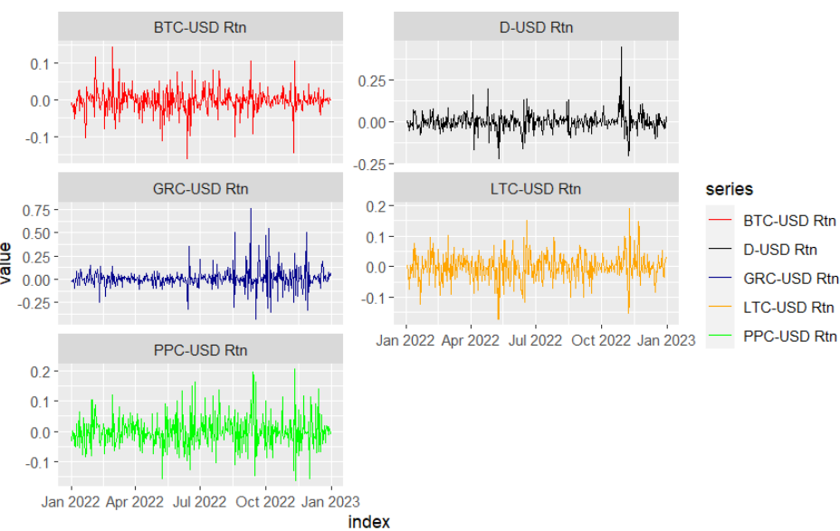
FIVE CRYPTO DAILY RETURNS ON SEPARATE AXES
Notes:
Again, we plotted the daily returns of the 5 cryptocurrency prices but this time we plotted them on a separate axis. Although this graph appears to be clearer than the previous one, it fails to illustrate how the five cryptocurrency prices compare to one another.

Slide 10
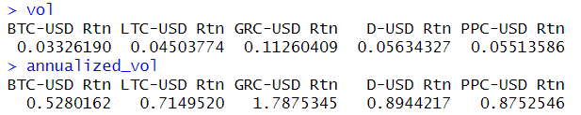
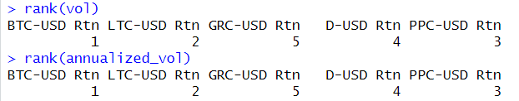
VOLATILITIES RANKED
We then used the function sapply() to compute the volatility and the annualized volatility for the daily returns, over the given sample period:
We then ranked the five cryptocurrencies’ volatilities to find out which ones had the highest and lowest volatilities:
Notes:
We then used the function sapply() to compute the volatility and the annualized volatility for the daily returns, over the given sample period. To compute the annualized volatility, we multiplied the sapply() function by the sqrt of 252 where 252 are the number of trading days in a year.

Slide 11
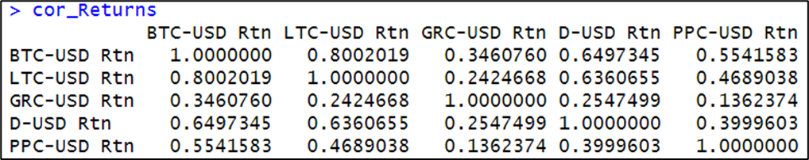
CORRELATION MATRIX
Notes:
From the correlation matrix computed above, we note that Bitcoin and Litecoin have the highest correlation of 0.8002019 and that Peercoin and Gridcoin have the lowest correlation of 0.1362374. The high correlation between Bitcoin and Litecoin can be explained by the fact that Bitcoin has higher returns, but it is also riskier than Litecoin which leads them to be highly correlated.

Slide 12
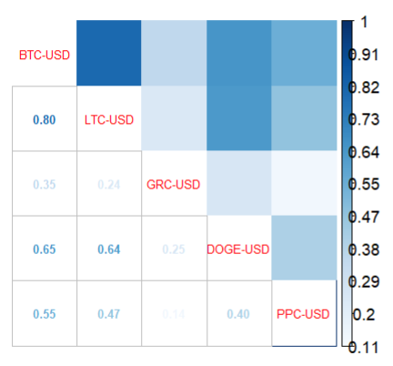
CORRELATION CHART
Notes:
From the correlation chart computed here, we confirm that Bitcoin and Litecoin have the highest correlation and that Peercoin and Gridcoin have the lowest correlation.

Slide 13
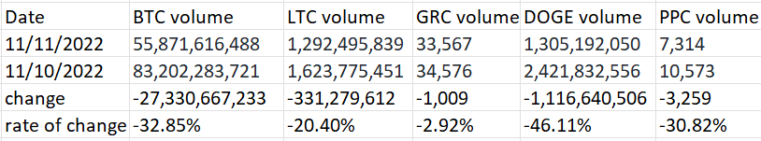
FTX impact on the five cryptocurrencies
trading volume
all the five cryptocurrencies have dropped
trading price
go up
Litecoin
go down
Bitcoin, Gridcoin, Dogecoin, and Peercoin

Slide 14
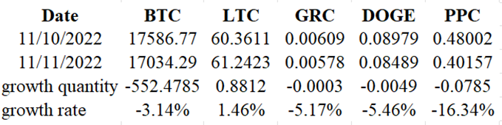
Observe the price change on the 10th and 11th from the table

Slide 15
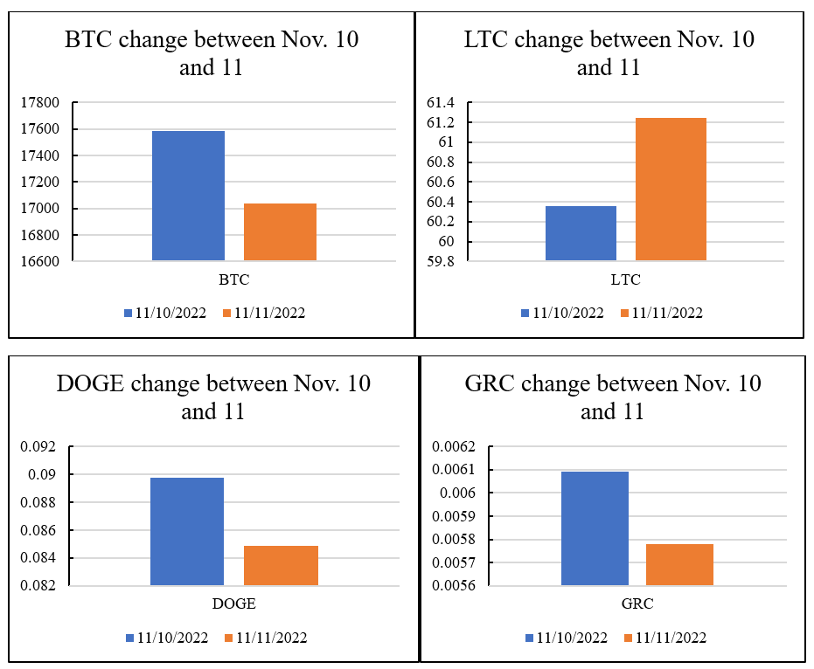
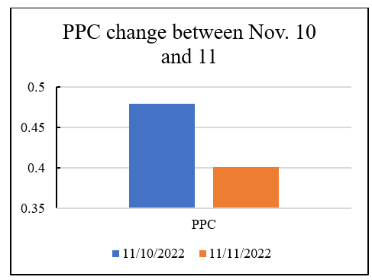
Observe the price change on the 10th and 11th through chart

Slide 16
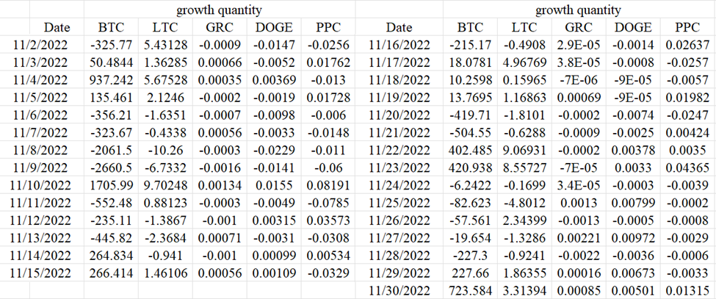
The five cryptocurrencies’ prices change in November 2022

Slide 17
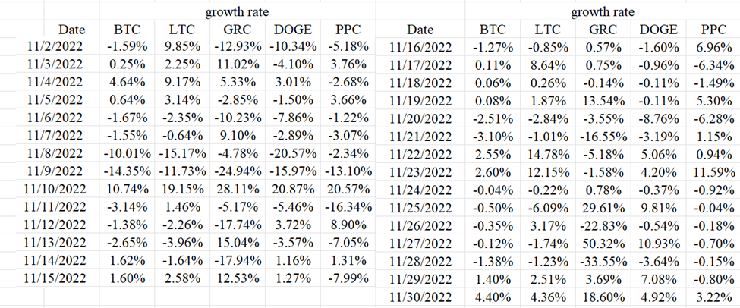
The five cryptocurrencies’ prices change in November 2022 --continue

Slide 18
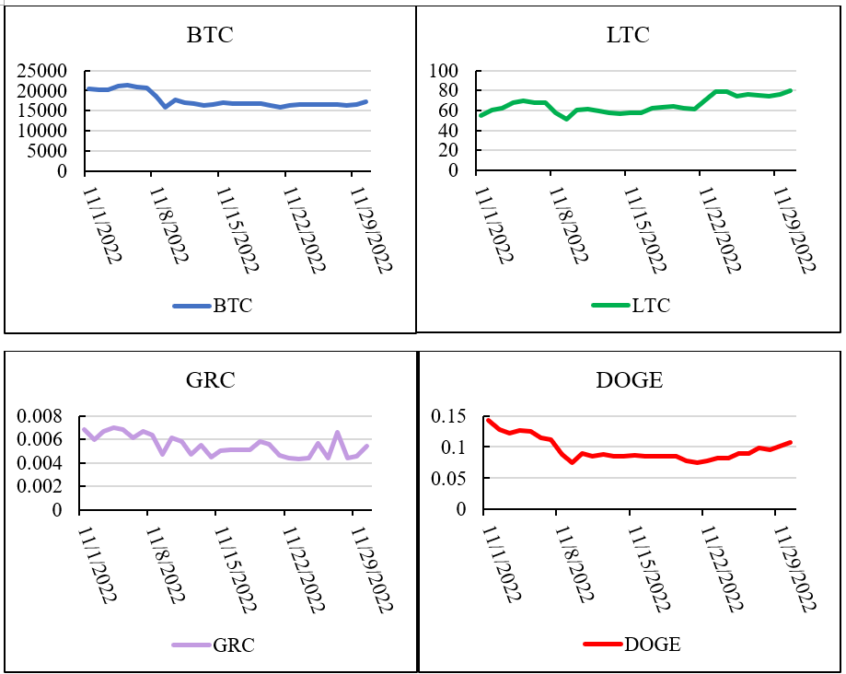
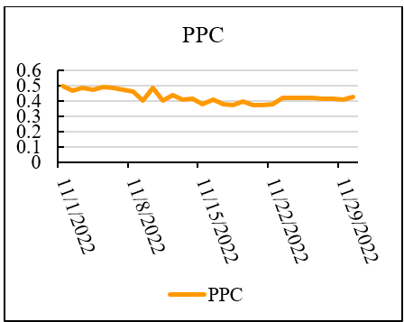
Observe the price change in November through graph

Slide 19
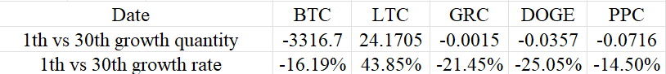
Comparing the 1st and the 30th of November

Slide 20
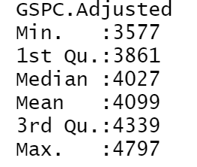
SP500 Daily Price

Slide 21
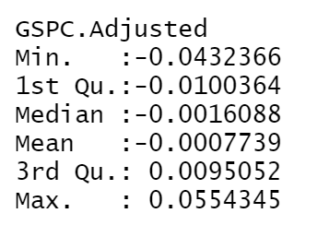
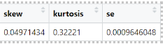
SP500 Daily Return

Slide 22
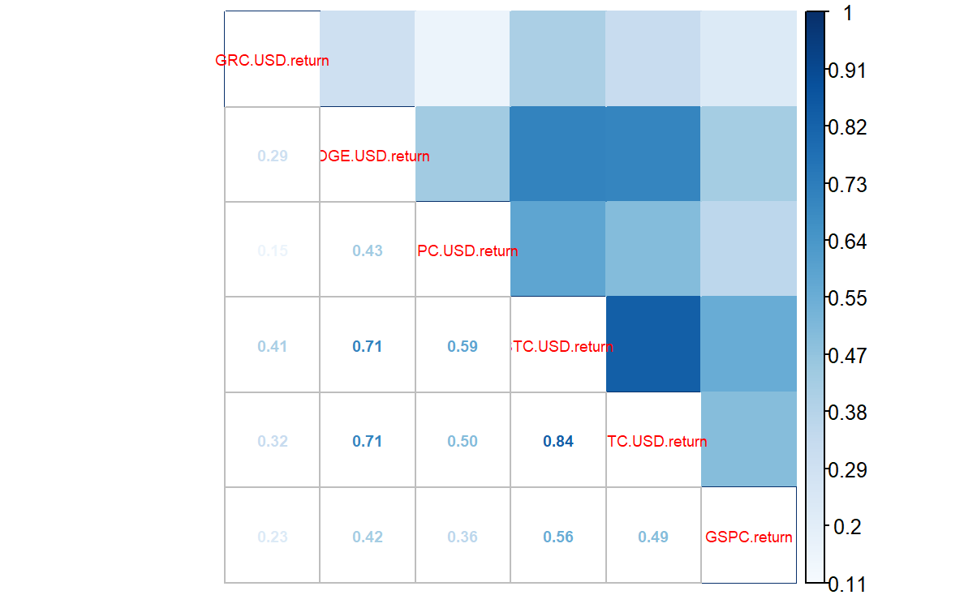
CORRELATION CHART
From the plot, Litecoin has a relatively high correlation with Bitcoin. And all cryptocurrencies have a positive correlation with the market index.

Slide 23
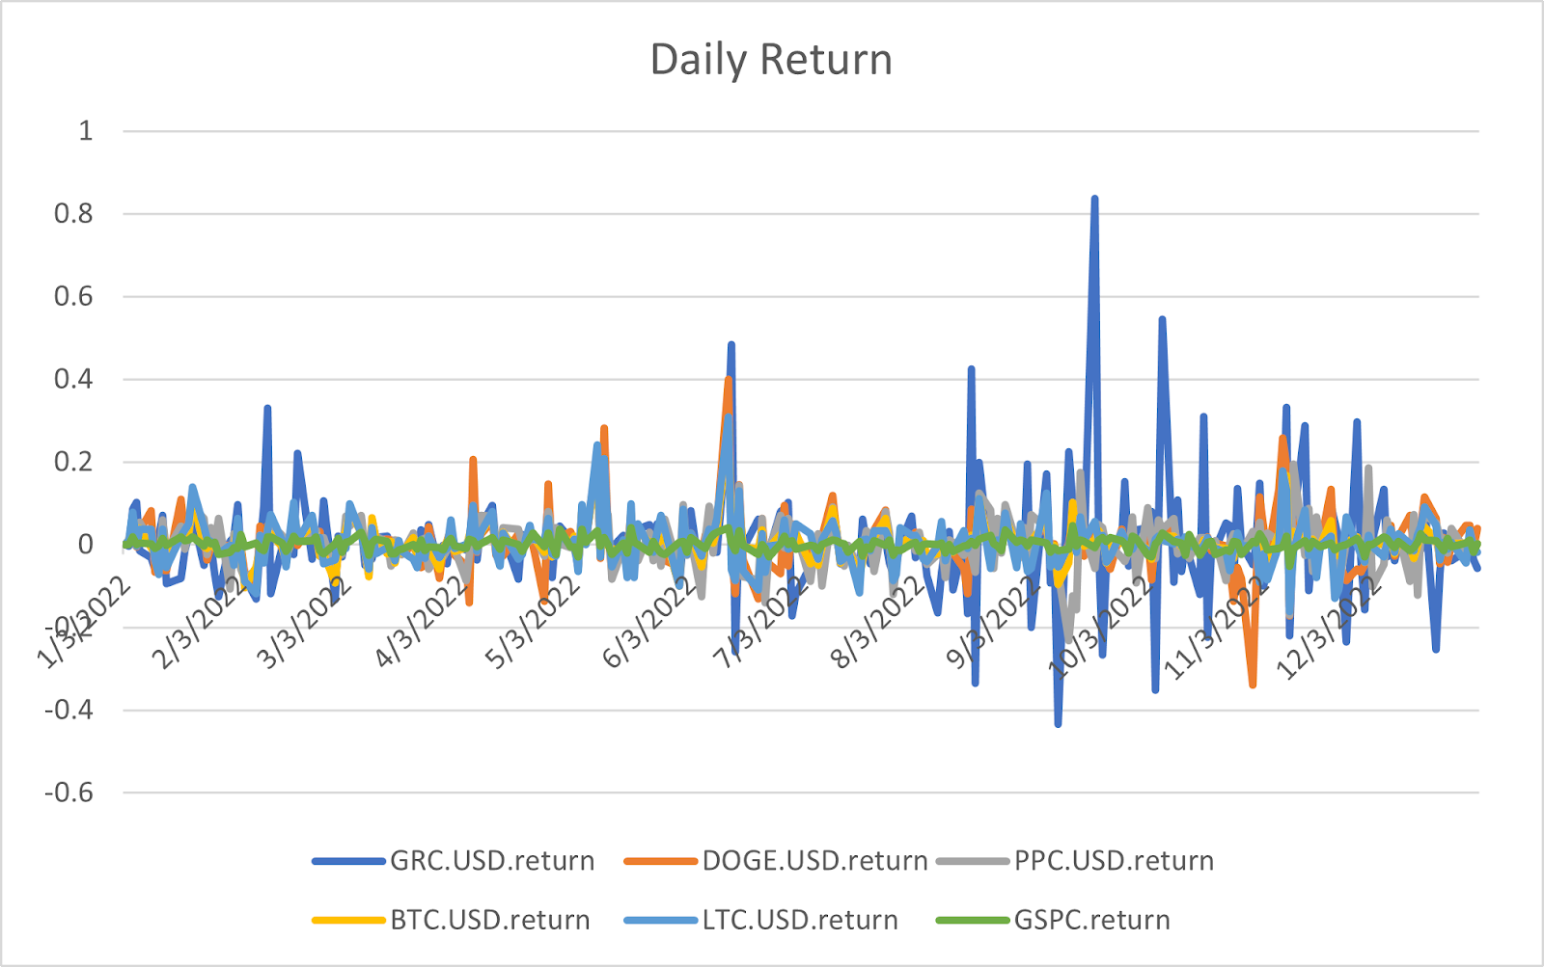

Slide 24
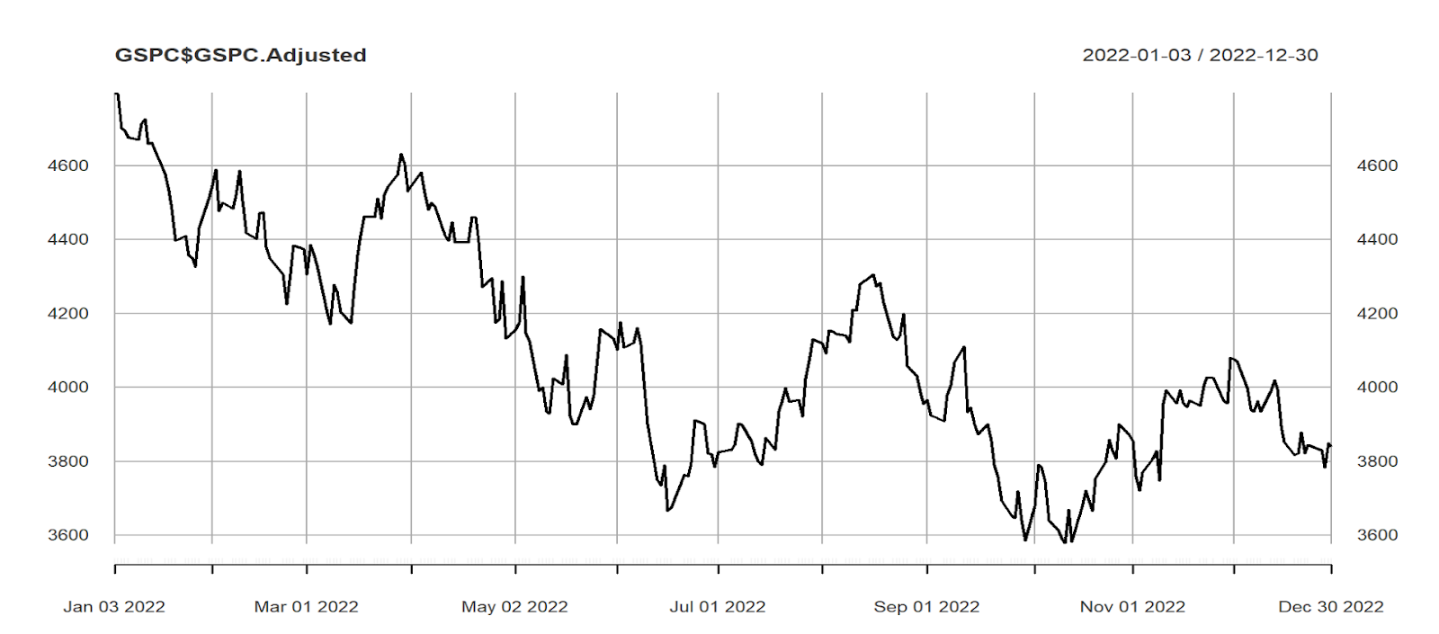
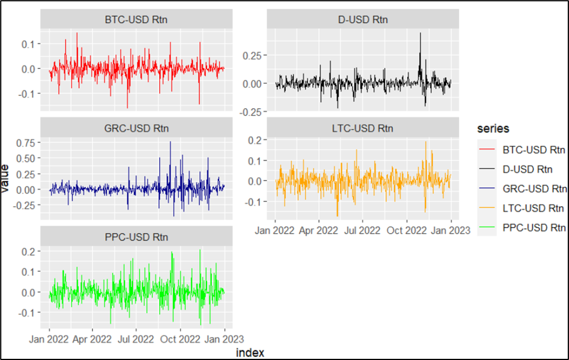
We can see after that FTX event happened on Nov.11th, SP500 experienced a rise compared to the five cryptocurrencies, although they have a positive correlation. Because correlation does not necessarily imply causation, it's possible that the up trend in the S&P 500 was not directly related to the failure of FTX .

Slide 25
Conclusion
No matter the daily prices, daily returns, standard deviations for the market index, Bitcoin price fluctuations are the smallest, so it can be concluded that people are more enthusiastic about Bitcoin than the other four cryptocurrencies. However, they are all heavily influenced by the news of the failure of FTX in mid-November 2022.
Though SP500 has a positive correlation with most cryptocurrencies, it still can play an important role to diversify the unsystematic risk when things like FTX happen.

Slide 26
Echo Link + Academic Link
= Trustless Job Market

Slide 27

The Business Problem
Inflated Job Market
Monopolistic and Opaque Intermediary
Mouse and Cat game
Geographic Limitation

Slide 28



Stakeholders
Students
Institutions
Employers
Create a fair job market
Needless to prove your experience
Eliminate Counterfeits
Help Students Land Job
Reduce Bad Hires
No Verification costs

Slide 29

Why Blockchain
Public
Open
Robust
Consistent Records and Traceability
Borderless and Trustless Verification
Hard to Manipulate or Alter

Slide 30
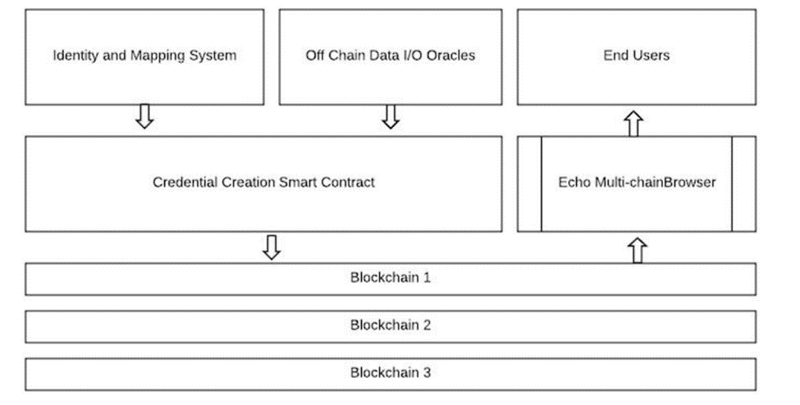


Echo Link
Realistic Functional Design
Addressed Privacy Issues
Experience Inflation Unsolved
Security Concerns
Reliance on Oracles

Slide 31



Academic Link NFT Based System
Individual
Experience/Degree Token
Institution
Master Token
Department
Subsidiary Token
Degree information with diploma & transcript Picture
Experience & Skill Statement
Acquired through Weighted Institution Registration
Can be used to create Departments (Subsidiary)
Created by Master Token
Can Verify Statements or Degree Token

Slide 32
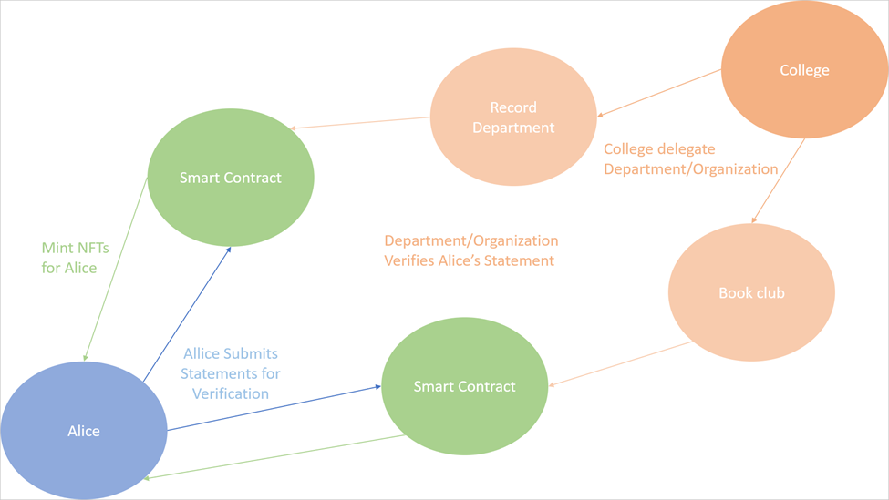
Academic Link A Bird Sight View

Slide 33
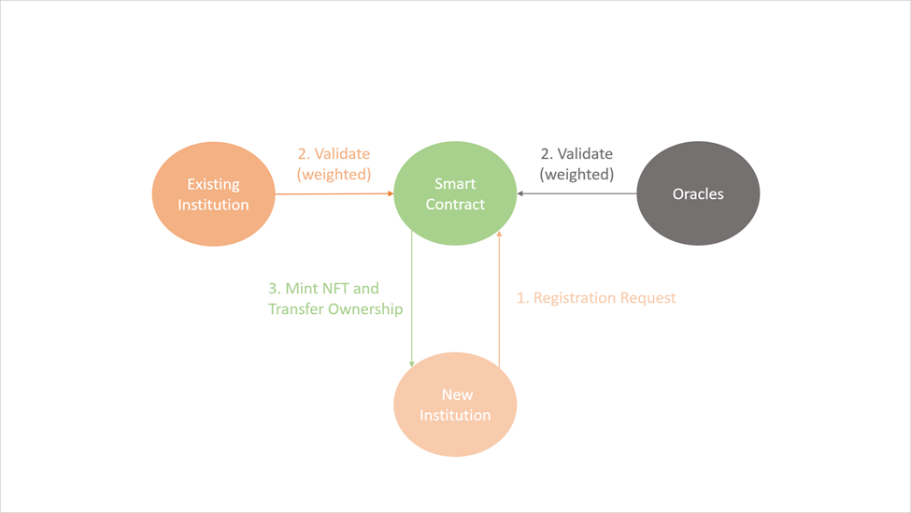
Academic Link Weighted Verification System
Community Consensus Based Authentication
Eliminate Impersonators
Reduced Costs

Slide 34
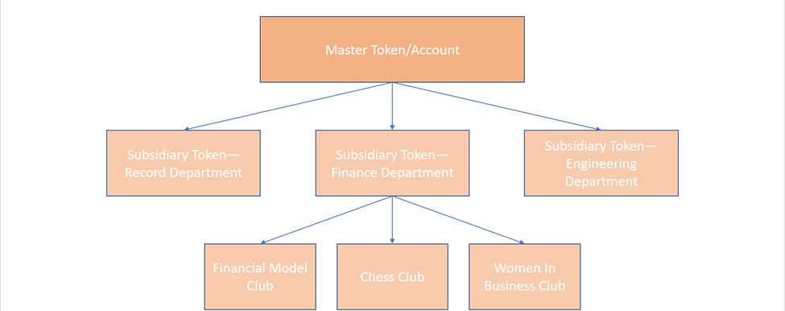
Academic Link Subsidiary Delegation

Slide 35
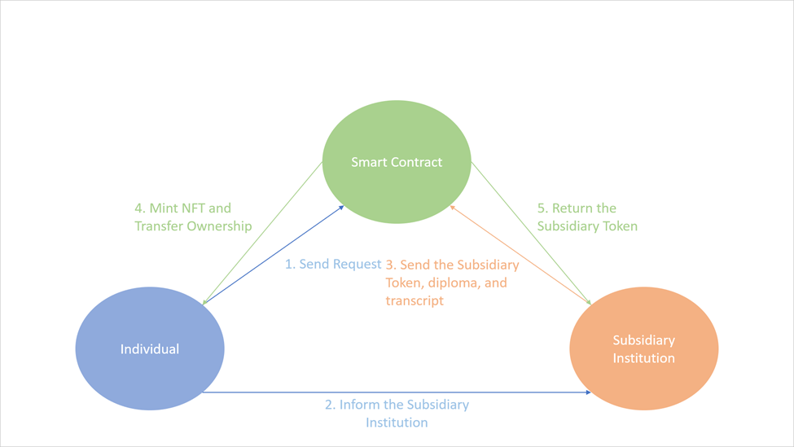
Academic Link Individual NFT

Slide 36
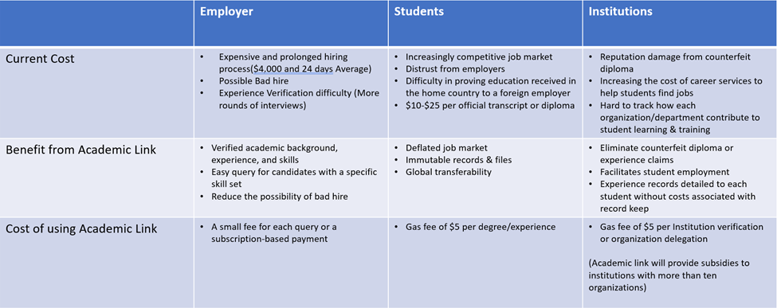
Cost & Benefit

Slide 37
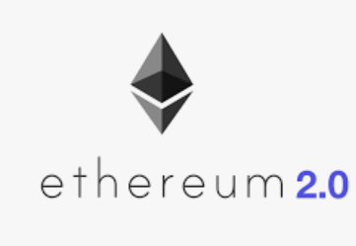

Implementation
Best suited for Ethereum 2.0
Better Scalability
Lower Cost
Greater Utility
Other PoS chain like Polygon
Even Lower Cost
Security Concerns

Slide 38
THANK YOU!
Stevens Institute of Technology
1 Castle Point Terrace, Hoboken, NJ 07030

